Slide 1
Lecture 26: Holistic Development towards
Humane Society and Tradition

Slide 2


Slide 3
Recap
We saw how right understanding provides the foundation for the identification of universal human values in all the dimensions of life.
It also facilitates the recognition of the definitiveness of ethical human conduct.
Moving on to other important implications of right understanding, in this lecture, we will see how right understanding enables us to visualise holistic development resulting into a humane society (undivided society and universal human order) and humanistic tradition.
We have already explored into how a humane society would be, and we will recall that in brief for our ready reference.

Slide 4
Visualization of Comprehensive Human Goal
An important implication of the right understanding is the visualization of comprehensive human goal which is conducive to human welfare (wellbeing of all).
In the light of the right understanding, it is possible to visualise the pattern of a holistic way of life to ensure the fulfillment of comprehensive human goal, a model of human living which is people-friendly and eco-friendly, therefore, sustainable.

Slide 5
The Vision for Holistic Development and Humane Society
On the basis of the understanding of harmony, we get the notion of a Humane Society- i.e. undivided society and universal human order.
The universal human order will involve:
  A holistic pattern in all the dimensions of human activity in the society including education, health-self-regulation, production-work, justice-preservation, exchange-storage, etc.
  Harmonious networking between the basic unit and their clusters successively moving from family order to world family order as follows:
  Family Order ⇒ … ⇒ Village Order ⇒ Village Cluster Order ⇒ … ⇒ Nation Order… ⇒ World Family Order
  In each of these dimensions, we can visualise a humane system, be it education, health, production, exchange or justice and conceptualise a harmoniously functioning overall system.

Slide 6
Harmony in Society – Universal Human Order
Human Goal
Systems / Dimensions of Human Order
1. Education – Sanskar - f”k{kk laLdkj
  2. Health – Self-regulation - LokLF; la;e
  3. Production – Work - mRiknu dk;Z
  4. Justice – Preservation - U;k; lqj{kk
  5. Exchange – Storage - fofue; dks’k
Scope –From Family Order to World Family Order (Universal Human Order)
Family – Family cluster – Village – Village cluster ... Nation ... World Family
Order Order Order Order Order Order
~10¹ ~10² ~10¹⁰
Right Understanding & Right Feeling
Prosperity
Fearlessness
(Trust)
Co-Existence
(mutual fulfilment)
Happiness
In Every Individual
In Every Family
In Society
In Nature/ Existence

Slide 7
Paving the Way towards a Humanistic Tradition
The primary step to move towards the holistic way of life is to develop the right understanding among the human beings, commitment to live accordingly and then to develop the requisite skills and knowledge systems to implement the right understanding in real life. Thus, it calls for a change in the education system towards humanistic education. The right understanding provides us with the vision of such a humanistic education.
The humanistic tradition can be visualised in terms of the following four aspects of a humane society-
  Humanistic Education
  Human Conduct
  Human Constitution
  Universal Human Order

Slide 8
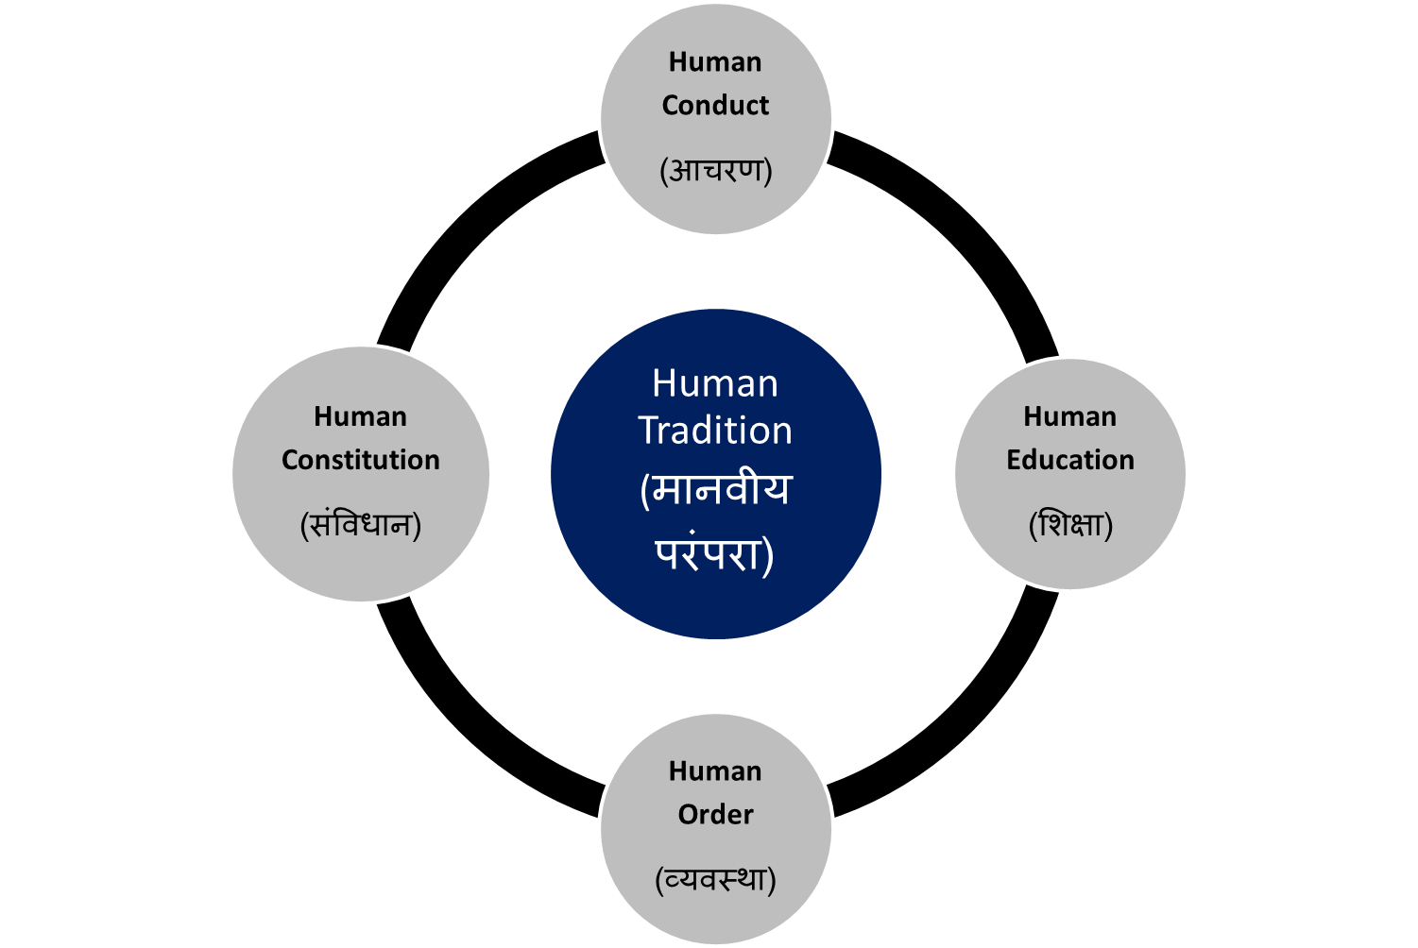
Human Tradition (in which Human Goal is fulfilled generation to generation)
Conduct that ensures
continuity of mutual
happiness &
prosperity
Education that
ensures the
development of the
competence to live
with
Definite
Human
Conduct
Nature of
society
of people living
together in a
relationship of
mutual fulfillment
Entry Point
The society in which
Human Goal
is realised

Slide 9
Human education, constitution…
We have already defined these in module 1-4; however, we are recalling the essense of these for ready reference:
Human education- Education that ensures the development of the competence to live with Definite Human Conduct through right understanding and right feelings.
Human conduct- Conduct that ensures continuity of mutual happiness & prosperity through living with right understanding ad right feelings.
Human constitution- Nature of society of people living together with human conduct i.e. in a relationship of mutual fulfillment
Universal human order-The society in which Human Goal is realised through different dimension of human systems
Humanistic tradition- Continuity of humane society generation after generation- in a self-sustaining manner.

Slide 10
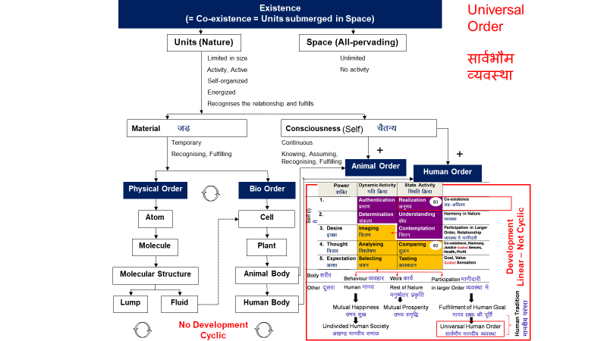
Humane society and Human tradition- a natural process
Important thing to note here is that-
This humane society and human tradition is something which is a natural outcome of the existential harmony (order) already existing and unfolding itself through a natural process, and this process is to be completed through human being.
To meaningfully participate in this natural process, human being has to understand this existential harmony (order) and live in accordance with it.
It is not just a human construct, though, it is articulated and expressed by human being in different ways.

Slide 11
Key Takeaways
Humanistic education leads to human conduct, human constitution, universal human order and in turn, universal human order ensures humanistic education for the next generation.
The entry point in setting the wheel of humanistic tradition rolling, is humanistic education.
Important thing to note here is that-
This humane society and human tradition is something which is a natural outcome of the existential harmony (order) already existing and unfolding itself through a natural process, and this process is to be completed through human being.
To meaningfully participate in this natural process, human being has to understand this existential harmony (order) and live in accordance with it.
It is not just a human construct, though, it is articulated and expressed by human being in their own way

Slide 13
Different Approaches to Ethics and Professional Ethics
 | Prevalent (Prescriptive) | Proposed (Humane)
Basis | Assumptions (thought) | Right Understanding of co-existence, harmony and relationship
Feeling | Opposition | Relationship
Values | Assumed values – based on assumptions and opposition | Naturally acceptable values, Wellbeing of all
Ethics: How to interact with the world outside | Mostly prescriptive, in the form of do’s and don’ts | Details based on right Understanding (as described)- verifiable by everyone thru NA Basic agreements for order in society
Way of ensuring in society | Training, Discipline Incentives and punishment | Human Education, Self-discipline Self-motivation

Slide 14
Competence in Professional Ethics
Guidelines for how to interact with various levels of realities through the profession, which is making effort for fulfilment of some part of the human goal
Entity (realities) Competence for
Human beings Behaviour – mutual fulfilment
Rest of nature Work – mutual prosperity
Maintenance, etc. Service (seva)* – promotion of harmony
Societal systems Participation in larger order – promotion of harmony
*service which promotes harmony in family, society at all levels

Slide 15
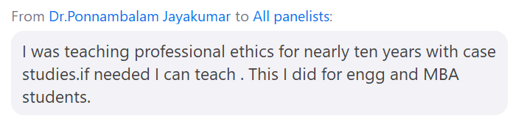
Old Lecture?

Slide 16
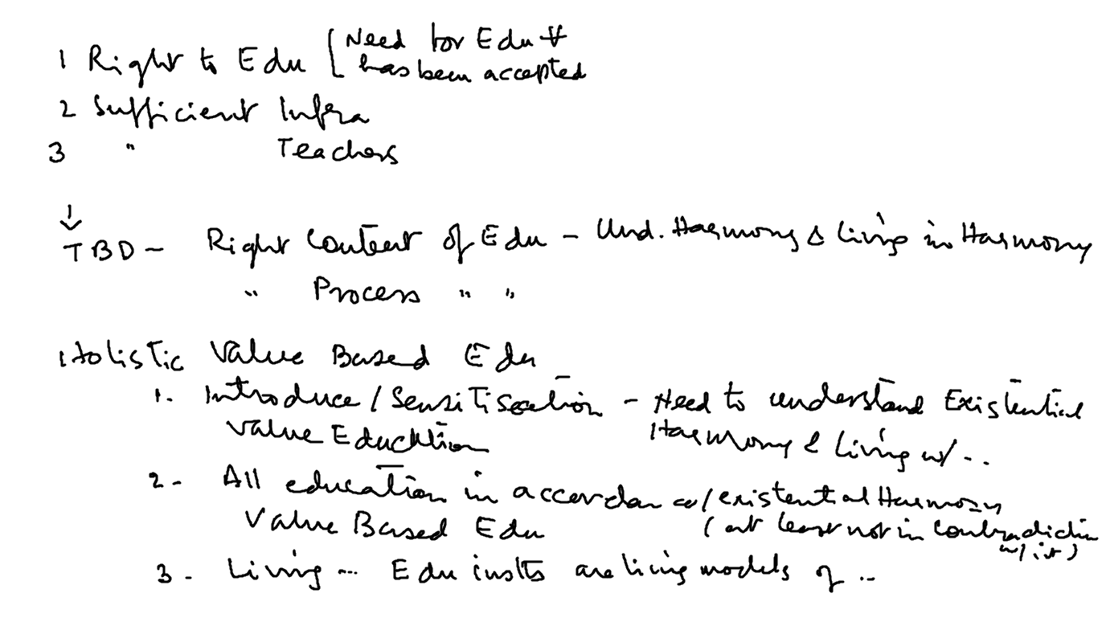

Slide 18
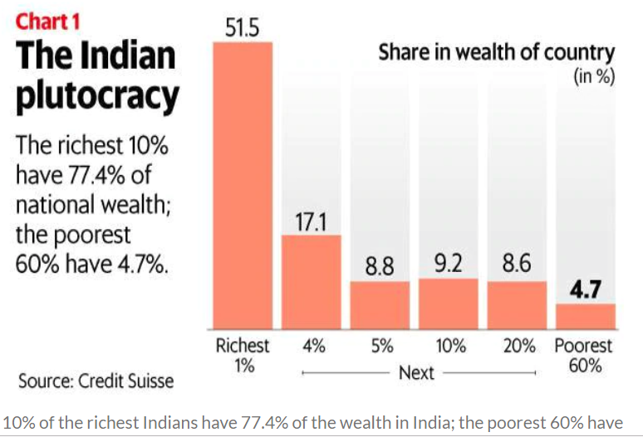
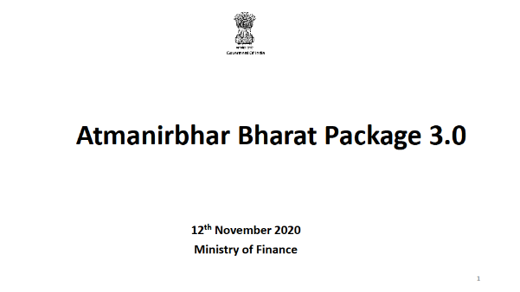
Present State – Profit Maximisation, Domination…
Packaged water Rs. 20/lit
Organised sector
Wheat support price Rs. 19/kg Unorganised sector
Organised Unorganised
Employment 6-15% 85-94%
Production “value” 47% 53%

